Slide 1

FUTURE WIRELESS COMMUNICATION 5G ADVANCED/ 6G PROJECT
Presented By:
201FA05043-V. Lakshmi Revanth Kumar
201FA05070- K. Srilatha
201FA05076- D. Siva Krishna
Under the Guidance of
Mr. Satish Kanapala, M. Tech,
Assistant Professor
Department of ECE
VFSTR
Under the Guidance of
Dr. G V V Sharma
Associate Professor
Department of Electrical Engineering
Indian Institute of Technology Hyderabad

Slide 2
Contents
Introduction
Objective
Literature Survey
Data Handling
Hardware Programming
Vaman Board
Inter-Chip Communications Using Vaman Board
Conclusions
References

Slide 3
INTRODUCTION
Hardware programming includes programming of different ic’s using arduino droid.
Vaman board is a board containing different modules like arm, esp, fpga.
Inter-chip communication refers to the exchange of data between different modules within vaman board and ensures that various components work together efficiently, exchanging data and control signals as system.
Crucial for the performance, reliability, and power efficiency of electronic devices.
Can be used in : automotive systems, industrial automation, medical devices.

Slide 4
OBJECTIVE
To implement the inter-chip communication in vaman board between ESP and FPGA with an experience in hardware programming of ic’s for future wireless communication in 5G advanced/ 6G.

Slide 5
Literature survey
S.No | Research Paper | Year | Author | Purpose
1 | Catalyzing Autonomous Navigation Design Thinking across India | Volume 4, Issue 2, Apr –Jun 2022 | Dr. G V V Sharma | Testing of Vaman in real life application.

Slide 6
DATA HANDLING
Installations
Termux
Latex

Slide 7
Installations
Install f-droid
Now in f-droid
Install termux
Termux: APT
Setting up termux
Installing and setting up ubuntu on termux
Latex and python

Slide 8
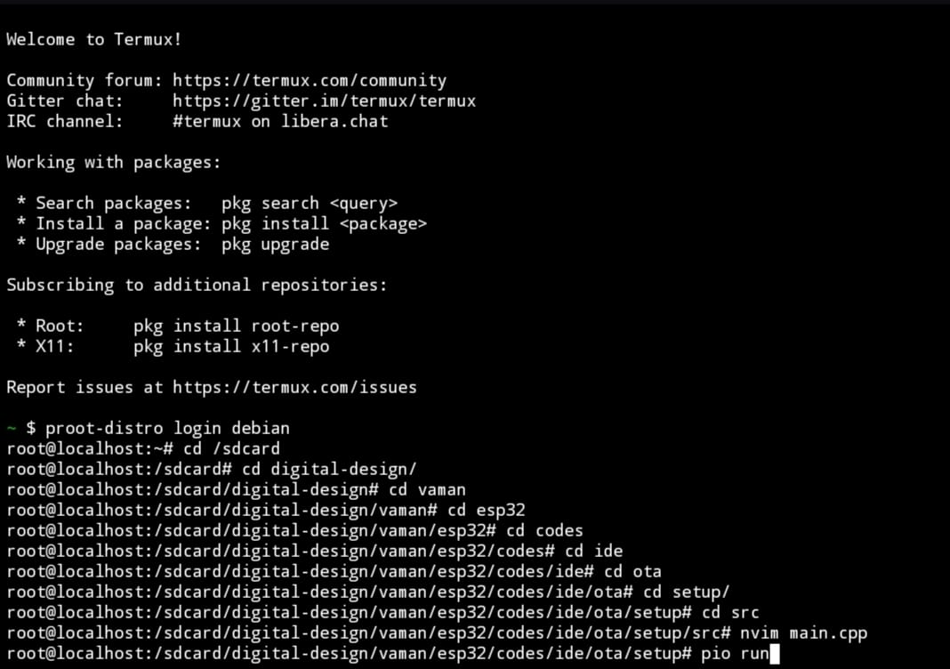
Termux
Termux is a free and open-source terminal emulator for Android which allows for running a Linux environment on an Android device.
Most commands available in Linux are accessible in Termux.
used to write and run code.
There are more than 1000 packages for various purposes, including code editors, compilers, etc.
To get Hands-on on Termux we started Latex.
Fig1:Termux Home Page

Slide 9
LATEX
LATEX is a document preparation system for the TEX typesetting program.
It has great ability in writing, controlling page layout, fonts, formatting, and ensuring a professional and consistent appearance.
Latex files contain markup language that enables them to be readily converted to other outputs
Used for the communication and publication of scientific documents.
An excellent tool for publications with complex formatting requirements. We can see the mathematical symbols produced by latex are higher resolution.

Slide 10
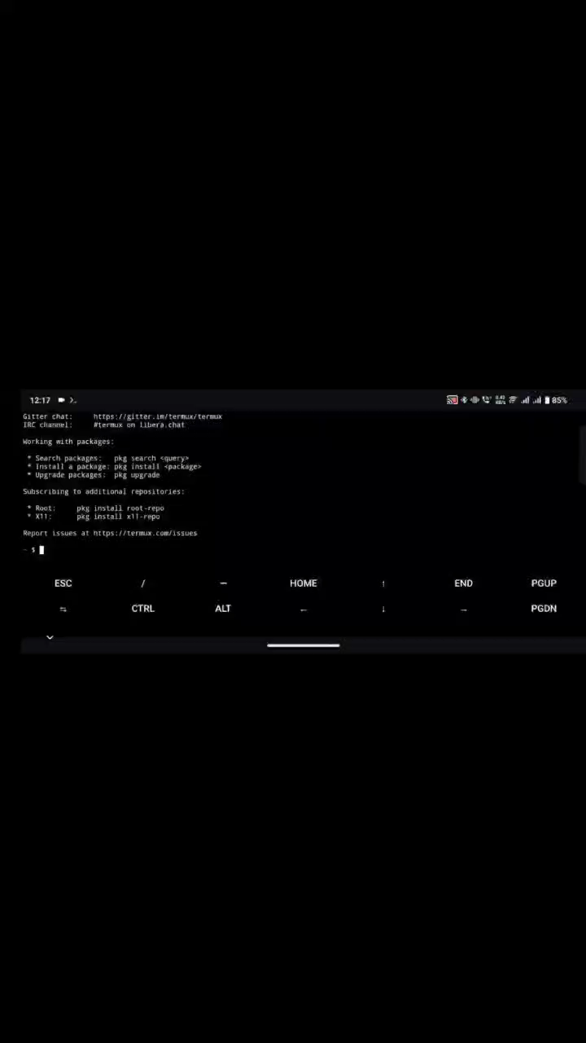
EXAMPLE

Slide 11
Hardware Programming
Platform.io
1. Seven Segment Display
2. 7447
3. 7474

Slide 12
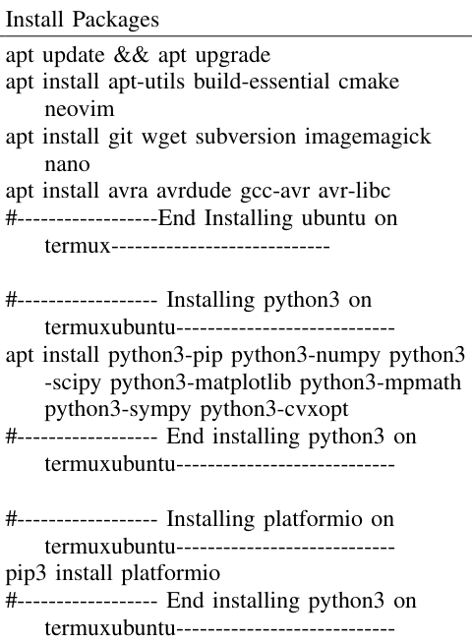
Platform.io
Platform.io is designed for getting hands-on on interfacing of Arduino
Here we practiced different tasks
After installing platform.io packages the termux will also work as open source platform as an Arduino IDE
We can directly generate a firmware. bin file which was a hexa-decimal coded by using PIO RUN command

Slide 13
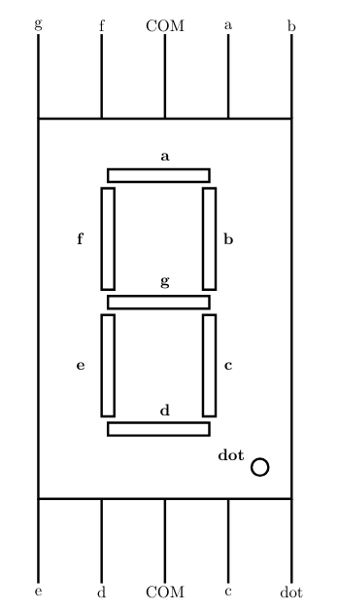
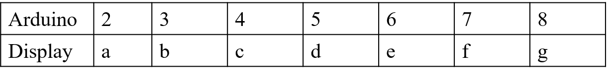
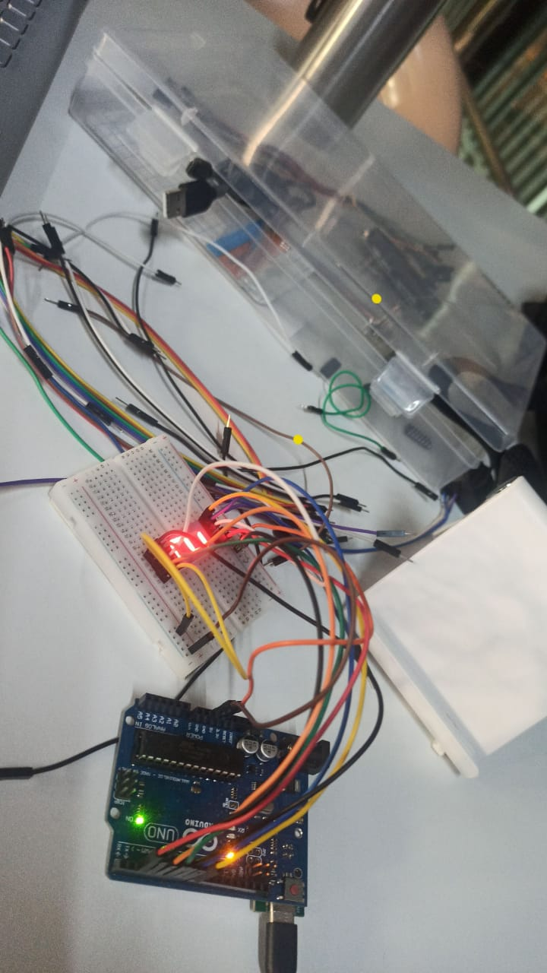
SEVEN SEGMENT DISPLAY
It has eight pins, a, b, c, d, e, f, g and dot.
Numbers from 0 to 9 can be displayed on this based on the given input to the pins .
Table1: Arduino to Seven segment display connections
Fig1: Pin Connections
Fig2: Sevenseg Output

Slide 14
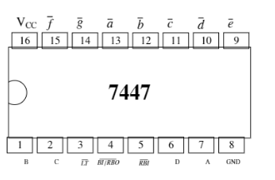
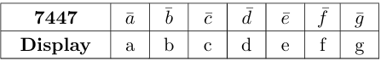
7447-BCD SEVEN SEGMENT DISPLAY DECODER
The 7447 BCD-seven segment display decoder to learn Boolean logic.
Input given is a binary number from 0000 to 10001.
The binary number is modified in code.
Table2: 7447 to display connections
Fig3: IC 7447 Pin Description

Slide 15
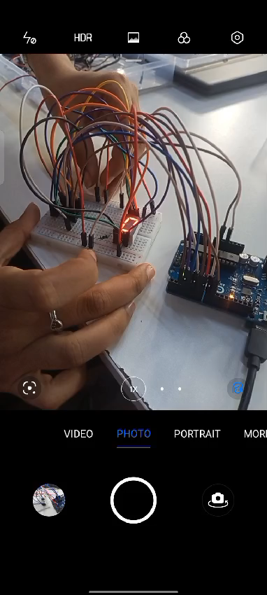
7447 OUTPUT

Slide 16
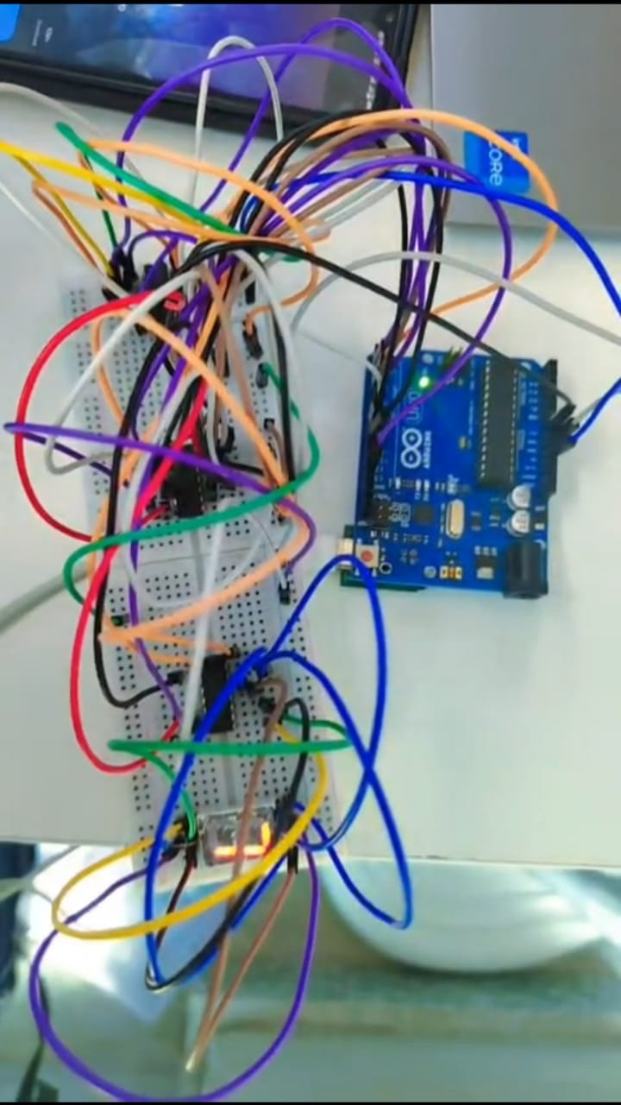
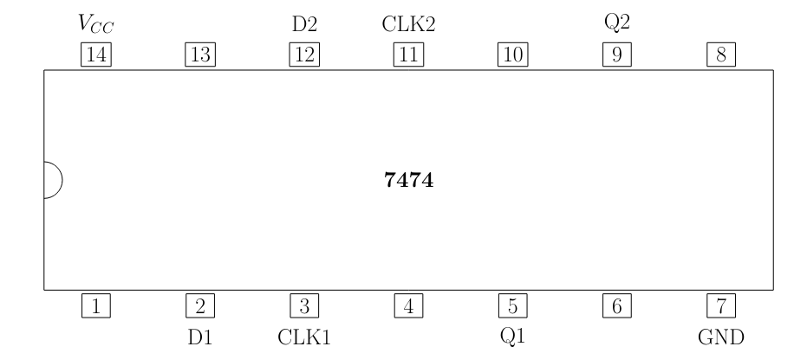
7474 - DECADE COUNTER
The 7474 d-flip flop ICs in a sequential circuit to realize a decade counter.
7474 decade counter generates numbers from 0 to 9 in seven segment display.
Fig6: Output for 7474
Fig5:7474 Pin description

Slide 17
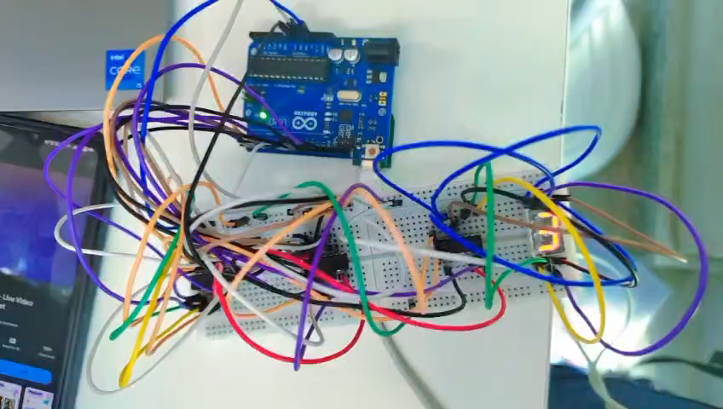
7474 OUTPUT

Slide 18
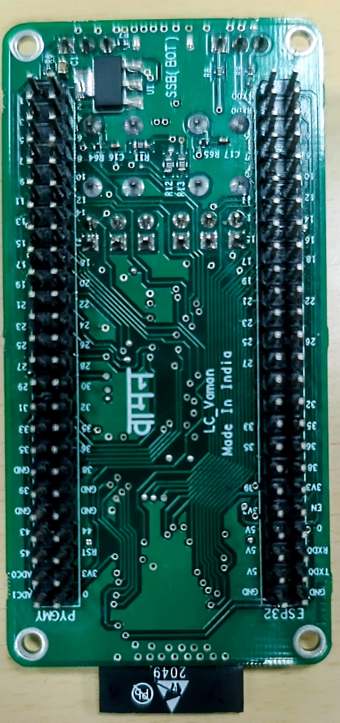
Vaman Board
The Vaman board is made in TIHAN organization in IIT Hyderabad, which is still in testing phase ,the main purpose of this board's research is to perform multitasking by integrating various boards.
Vaman Features:
Vaman board is a combination of 3 different boards namely ESP32, ARM, FPGA. Each one have unique features, unique code format, unique compilation process.
ex:ESP32 code needs C++ language, FPGA code needs to be in Verilog language.
Fig8: Vaman Board

Slide 19
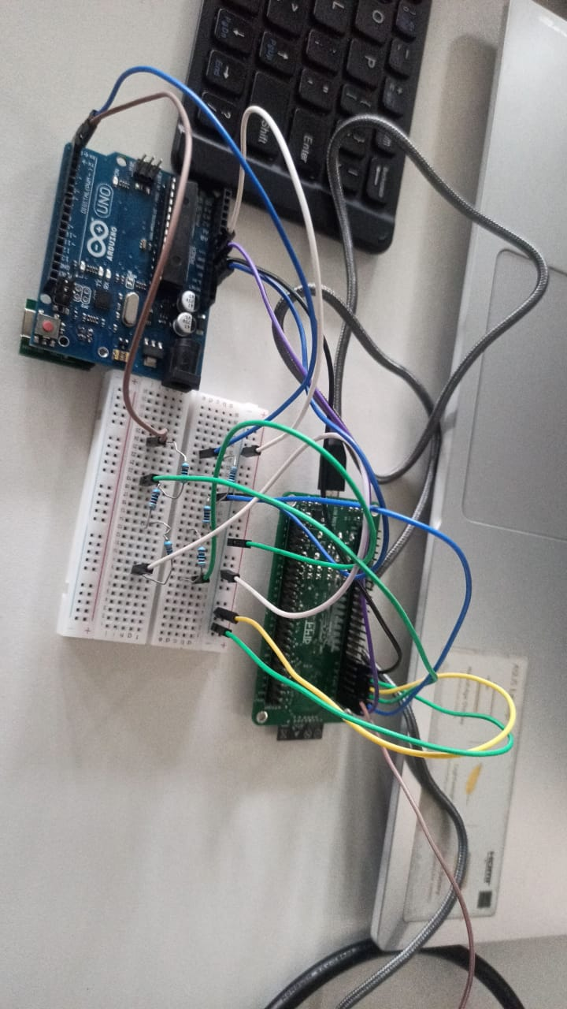
VAMAN - ESP32
The ESP32 microcontroller is the core processing unit on the vaman-esp32 board.
It provides wi-fi and Bluetooth connectivity.
It is suitable for IOT applications and wireless communication protocols.
ESP32 Advantages
Dual Core Architecture.
Wireless Connectivity.
Low Power Consumption.
Fig9: Vaman - ESP32 Hotspot Connctions

Slide 20
VAMAN - FPGA
The FPGA on the Vaman-pygmy board offers programmable logic resources.
It enables developers to implement custom digital circuits and perform hardware accelerated computations.
Verilog coding is used to program FPGA in Vaman.
FPGA Advantages
Flexibility
Hardware Acceleration
Reconfigurability

Slide 21
Math computing using Vaman ESP
To leverage the computational capabilities of the ESP32 microcontroller to solve mathematical problems.
Steps required to execute code with ESP in Vaman:
1. Code execution
2. Firmware upload
3. Wi-fi connection
4. Accessing IP address
5. Accessing web server
6. Interacting with web interface

Slide 22
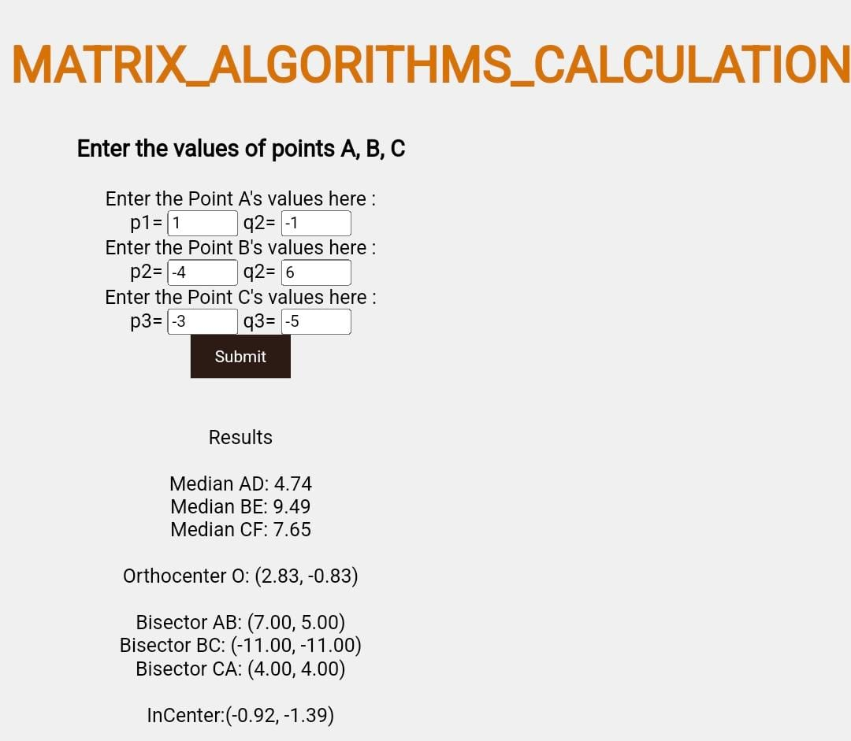
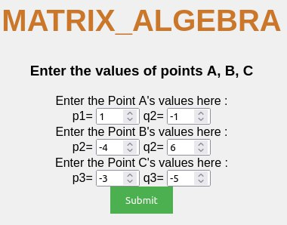
Example
To find the mat-alg of the triangle by using Vaman-ESP?
Fig10: Mat-alg calculation in Web page
Fig11: Output for mat-alg in Web page

Slide 23
Inter-chip communication
It demonstrates how various platforms on the Vaman (ESP32, ARM, FPGA) can communicate with each other through various protocols.
The communication could be between
1.ESP to ARM
2.ARM to FPGA
3.ESP to FPGA

Slide 24
block diagram
Web Page
ESP
FPGA
Seven segment/LCD Display
Fig12: Block Diagram for Inter-chip Communications

Slide 25
SEVEN SEGMENT DISPLAY
By the usage of SPI communication between the Vaman-ESP32 and the FPGA onboard the Vaman-pygmy by controlling a seven segment display remotely.
In ESP to FPGA communication the process involved is
1.Building and flashing
2.Accessing IP address
3.Accessing web server
4.Interacting with web interface

Slide 26
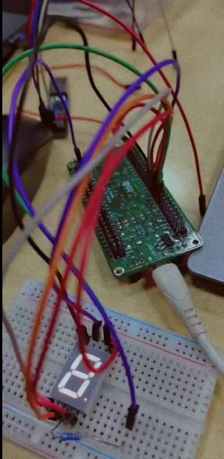
connections
Seven Segment Display | Vaman-pygmy
a | IO_1
b | IO_2
c | IO_3
d | IO_4
e | IO_5
f | IO_6
g | IO_7
COM | 3v3
Table3: Connections to Interface a Seven-Segment Display with Vaman-Pygmy
Fig13: Interface a Seven Segment with Vaman

Slide 27
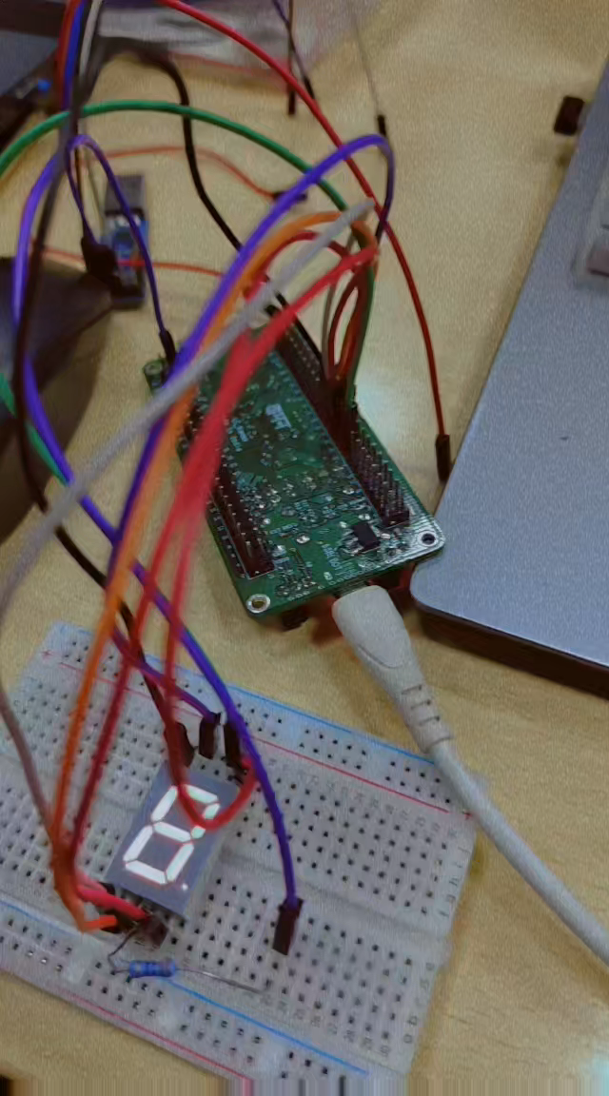
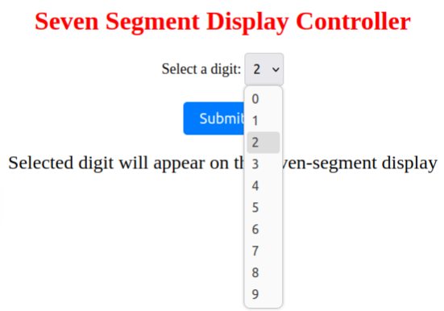
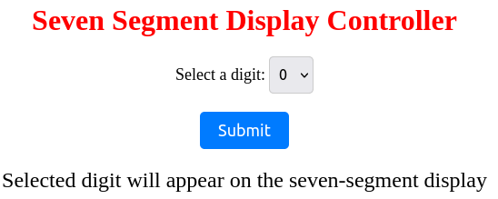
SEVEN SEGMENT DISPLAY OUTPUT
Fig14: Web page for selecting output to be displayed

Slide 28
LCD DISPLAY
By the usage of SPI communication between the Vaman-ESP32 and the FPGA onboard the Vaman-pygmy by controlling a LCD display remotely.
In ESP to FPGA communication the process involved is
1.Building and flashing
2.Accessing IP address
3.Accessing web server
4.Interacting with web interface

Slide 29
connections
Pygmy pins | LCD Pins | LCD pin label | LCD pin description
GND | 1 | GND
5V | 2 | Vcc
GND | 3 | Vee | Contract
10 | 4 | RS | Register select
GND | 5 | R/W | Read/Write
9 | 6 | EN | Enable
14 | 11 | DB4 | Serial connection
13 | 12 | DB5 | Serial connection
12 | 13 | DB6 | Serial connection
11 | 14 | DB7 | Serial connection
5V | 15 | LED+ | Backlight
GND | 16 | LED- | Backlight
Table4: Connections to Interface a LCD Display with Vaman-Pygmy

Slide 30
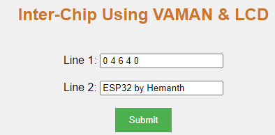
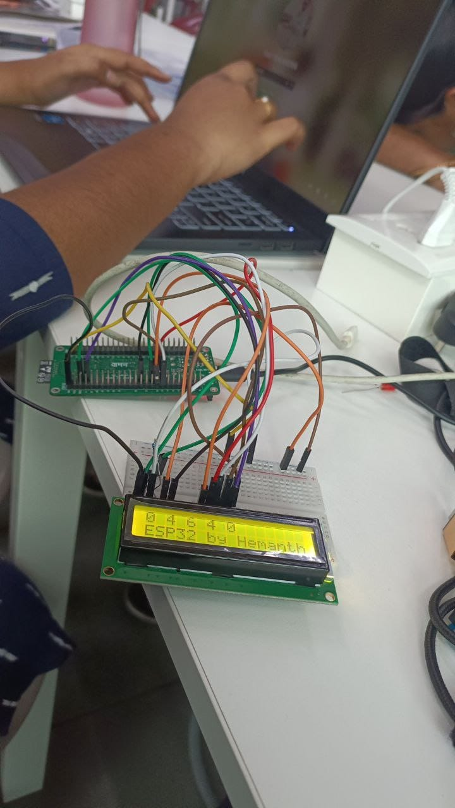
LCD OUTPUT
Fig16: Web page for selecting output to be displayed
Fig17: Output for Inter-chip using LCD & Vaman Board.

Slide 31
CONCLUSION
The project showcases the potential of inter-chip communication on the LC vaman development board, demonstrating integration between ESP32 and FPGA platforms. Through various experiments and exercises, to gain insights into hardware interfacing and communication protocols, paving the way for innovative embedded system designs in future wireless communications.

Slide 32
REFERENCES
Dr. G. V. V. Sharma. “Catalyzing Autonomous Navigation Design Thinking across India”, IITH research Dairy, vol. 4, issue 2, p.p. 10-12, 2022.
https://github.com/gadepall
https://github.com/gadepall/digital-design
https://github.com/gadepall/embedded-system
https://www.optimuslogic.in/product_pygmy.html

Slide 33

☺

